Slide 1


Diwali Sales Dashboard: ₹106.25M in Festive Success
Unveiling insights from our comprehensive Diwali sales analysis across 16 states, 1,250 customers, and multiple product categories. This data-driven story reveals the patterns behind India's most profitable festive season.

Slide 2
Executive Overview: The Numbers That Matter
₹106.25M
1,250
16
₹9.45K
Total Sales
Customers
States Covered
Average Spend
Record-breaking festive revenue
Active buyers during Diwali season
Pan-India market reach
Per customer transaction value
Our Diwali campaign achieved exceptional results, demonstrating the power of targeted festive marketing across diverse demographics and regions.

Slide 3
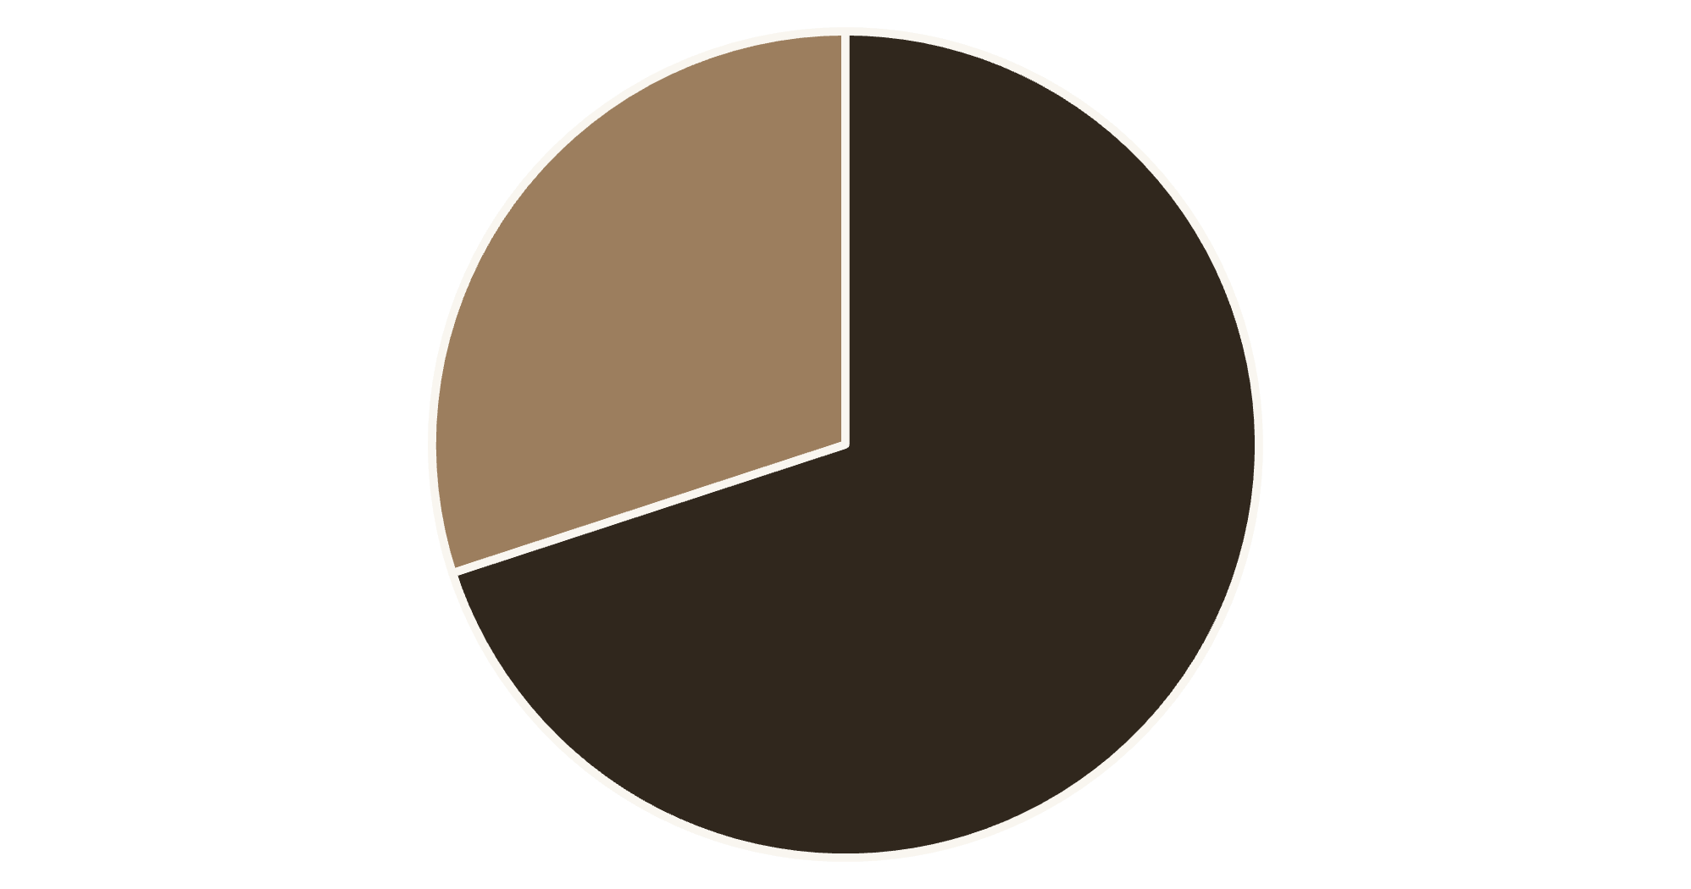
The Female-Driven Festival Economy
Women Lead Festive Shopping
Female customers account for 70% of total sales (₹74.34M), significantly outspending male customers who contribute 30% (₹31.91M).
This pattern reflects women's traditional role as household decision-makers during festivals, particularly for gifts, clothing, and home decorations.
Female
Male

Slide 4
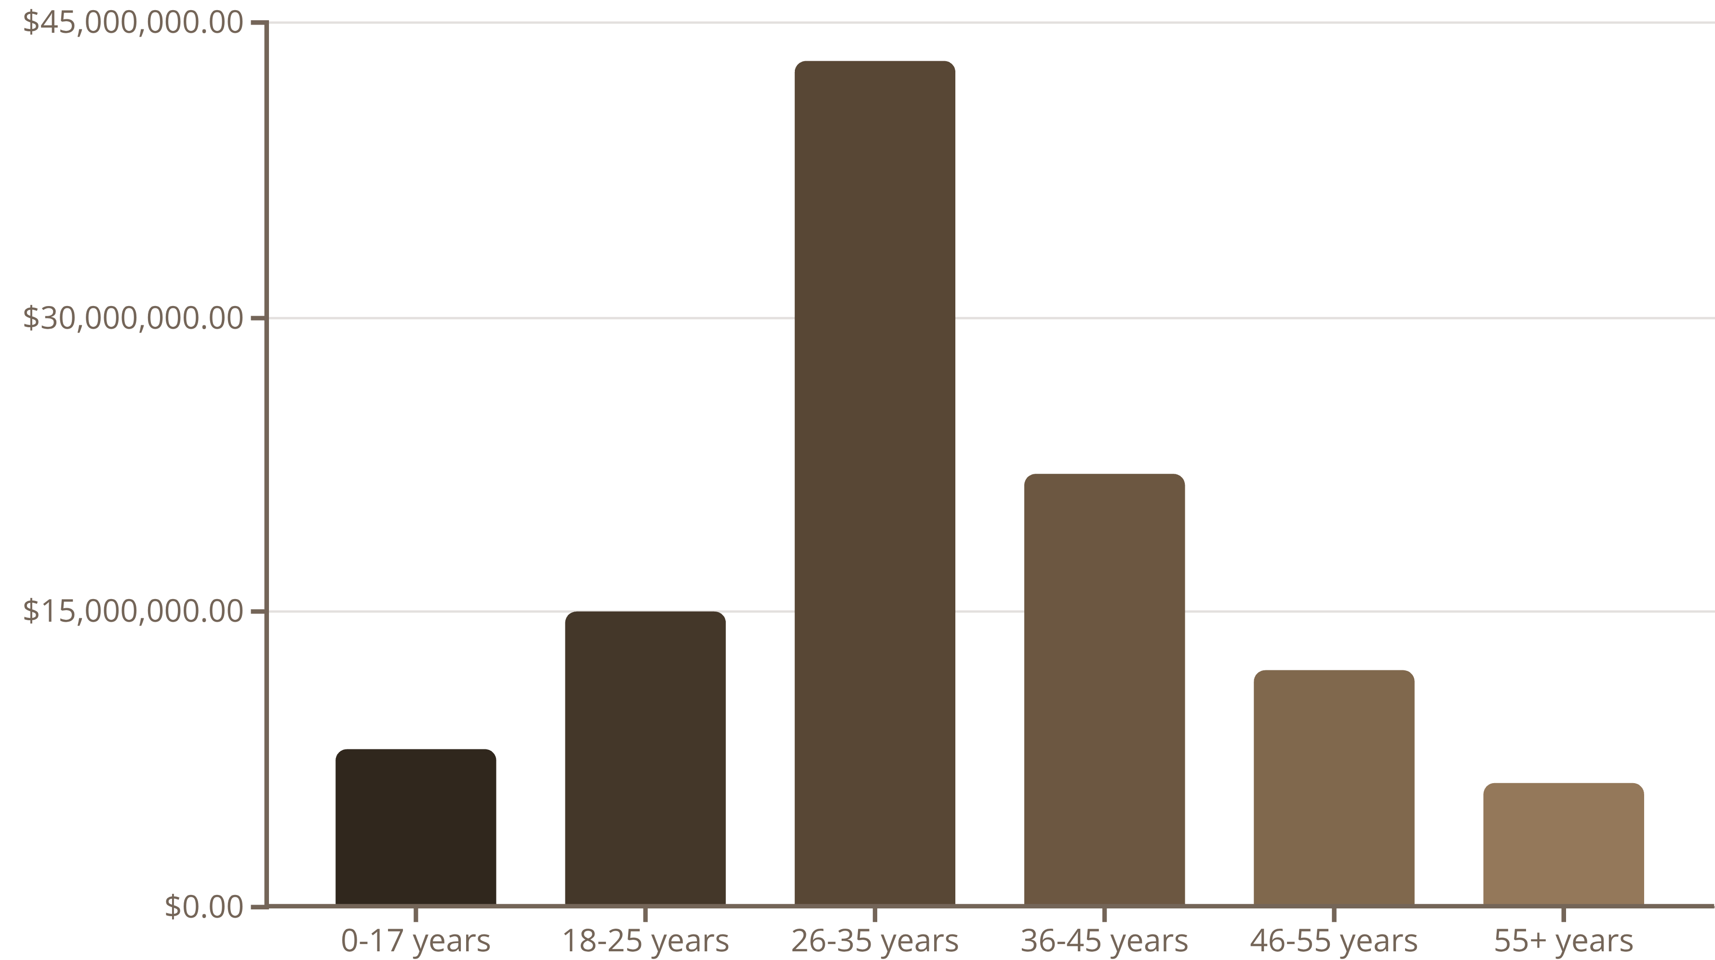
Age Groups: The Millennial Advantage
The 26-35 age group dominates with ₹43M in sales, representing peak earning years combined with family responsibilities. The 36-45 segment follows strongly with ₹22M, showing sustained purchasing power across middle-aged demographics.

Slide 5

Professional Spending Power
1
IT Sector Leads at ₹15M
Technology professionals demonstrate highest festive spending, driven by strong salaries and digital shopping comfort.
2
Healthcare & Aviation Tie at ₹13M Each
Essential service professionals show robust purchasing patterns, reflecting job security and steady incomes.
3
Banking Sector Contributes ₹11M
Financial sector workers maintain strong festive budgets, understanding the value of celebratory investments.

Slide 6
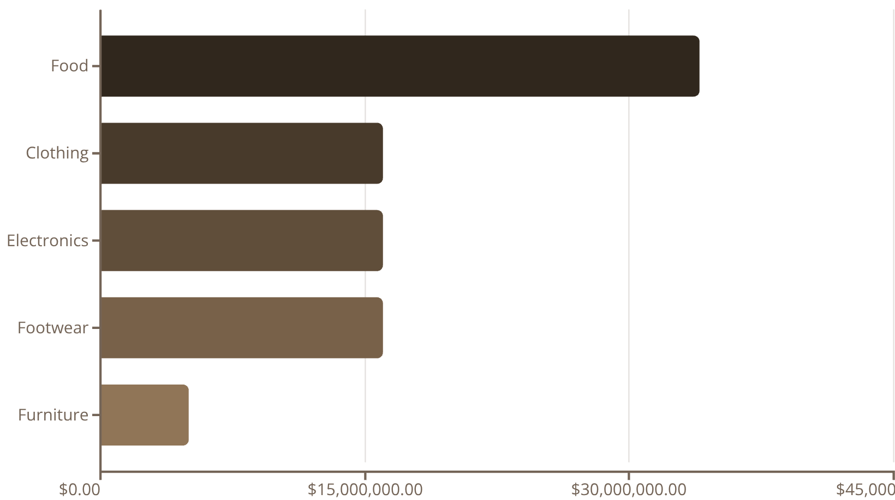
Product Categories: Tradition Meets Aspiration
Food Dominates Traditional Spending
Food leads at ₹34M, reflecting Diwali's emphasis on sweets, gifting, and family gatherings.
Clothing, Electronics, and Footwear each contribute ₹16M, showing how modern consumers blend traditional celebrations with aspirational purchases.

Slide 7




Regional Sales Distribution
39%
25%
Central Zone
Southern Zone
₹41.6M - Market leader
₹26.6M - Strong performer
17%
12%
Western Zone
Northern Zone
₹18.4M - Steady growth
₹12.6M - Emerging potential
Central and Southern India drive the majority of sales, with Uttar Pradesh (₹19M), Maharashtra (₹14M), and Karnataka (₹12M) leading individual state performance.

Slide 8



Key Strategic Insights
Female Power
Category Mix
Professional Segments
Women aged 26-45 are the primary growth drivers, accounting for the majority of high-value purchases across all categories.
Traditional food purchases remain dominant, while aspirational categories like electronics and footwear show strong growth potential.
High-income professionals in IT, healthcare, and banking demonstrate the strongest festive spending patterns and brand loyalty.

Slide 9




Strategic Recommendations
Targeted Marketing
Focus campaigns on female shoppers aged 26-45 with personalized promotions emphasizing family and tradition.
Expand Aspirational Offers
Develop premium electronics, clothing, and footwear bundles with exclusive festive discounts and financing options.
Regional Investment
Increase marketing spend in Central and Southern regions while building awareness campaigns in Eastern markets.
Occupation-Based Targeting
Create exclusive corporate partnerships and loyalty programs for IT, healthcare, and banking professionals.

Slide 10

Next Steps
Immediate Actions
Long-term Strategy
Launch female-focused campaign designs
Build aspirational product portfolios
Develop professional segment offers
Invest in Eastern region development
Expand Central/Southern presence
Create year-round loyalty programs
With these insights, we're positioned to make next Diwali even more successful—transforming data into meaningful customer connections and sustained growth.

